Slide 1

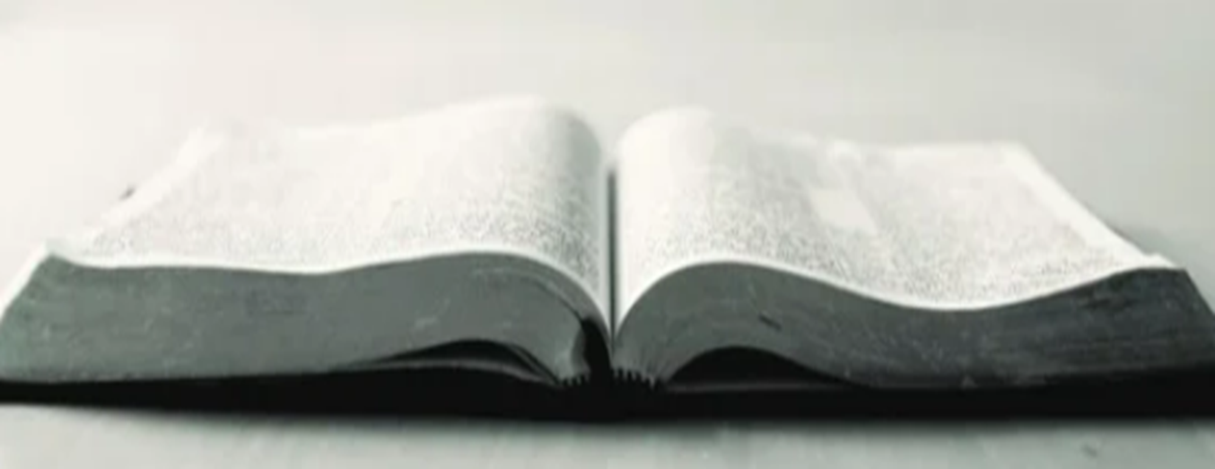
Understanding the Scriptures Cannot Be Broken
John 10:35
Notes:
Eddie Williams ~ July 20, 2014 (Eloy AM)
~ August 17, 2014 (Eloy AM)
~ March 6, 2016 (Eloy AM)
~ May 21 2017 (Eloy AM)
~ October 1, 2017 (Eloy AM)
~ October 27, 2019 (Eloy AM)
~ September 18, 2022 (Eloy AM)
~ October 2, 2022 (Eloy AM)
~ December 29, 2024 (Eloy AM)
~ July 27, 2025 (Eloy AM)
~ October 4, 2026 (Eloy AM)

Slide 2
Jesus said the scriptures can’t be broken
John 10:35 (KJV)
If he called them gods, unto whom the word of God came, and the scripture cannot be broken;

Slide 3
God Has Given to Man All Things That are Needed to Live a Life That Pleases Him

Slide 4
II Peter 1:3(KJV)
According as his divine power hath given unto us all things that pertain unto life and godliness, through the knowledge of him that hath called us to glory and virtue:

Slide 5
Everything God Requires of Man is Written in His Book, the Bible

Slide 6
II Timothy 3:15-17 (KJV)
15 And that from a child thou hast known the holy scriptures, which are able to make thee wise unto salvation through faith which is in Christ Jesus.

Slide 7
II Timothy 3:15-17 (KJV)
16 All scripture is given by inspiration of God, and is profitable for doctrine, for reproof, for correction, for instruction in righteousness:

Slide 8
II Timothy 3:15-17 (KJV)
17 That the man of God may be perfect, throughly furnished unto all good works.

Slide 9
Ephesians 3:3-4 (KJV)
3 How that by revelation he made known unto me the mystery; (as I wrote afore in few words, 4 Whereby, when ye read, ye may understand my knowledge in the mystery of Christ)

Slide 10
I Corinthians 14:37-38 (KJV)
37 If any man think himself to be a prophet, or spiritual, let him acknowledge that the things that I write unto you are the commandments of the Lord. 38 But if any man be ignorant, let him be ignorant.

Slide 11
To Please God, To Save Our Souls From Eternal Punishment, We Must Abide in the Doctrine of Christ

Slide 12
II John 9-10 (AMP)
9 Anyone who runs on ahead [of God] and does not abide in the doctrine of Christ [who is not content with what He taught] does not have God; but he who continues to live in the doctrine (teaching) of Christ [does have God], he has both the Father and the Son.

Slide 13
II John 9-10 (AMP)
10 If anyone comes to you and does not bring this doctrine [is disloyal to what Jesus Christ taught], do not receive him [do not accept him, do not welcome or admit him] into [your] house or bid him Godspeed or give him any encouragement.

Slide 14
Matthew 22:29 (LNT)
But Jesus said, “Your error is caused by your ignorance of the Scriptures and of God’s power!

Slide 15
Luke 6:46-49 (AMP)
46 Why do you call Me, Lord, Lord, and do not [practice] what I tell you?
47 For everyone who comes to Me and listens to My words [in order to heed their teaching] and does them, I will show you what he is like:

Slide 16
Luke 6:46-49 (AMP)
48 He is like a man building a house, who dug and went down deep and laid a foundation upon the rock; and when a flood arose, the torrent broke against that house and could not shake or move it, because it had been securely built or founded on a rock.

Slide 17
Luke 6:46-49 (AMP)
49 But he who merely hears and does not practice doing My words is like a man who built a house on the ground without a foundation, against which the torrent burst, and immediately it collapsed and fell, and the breaking and ruin of that house was great.

Slide 18
It’s Not in Man to Do What God Requires Without the Scriptures

Slide 19
Jeremiah 10:23 (KJV)
O LORD, I know that the way of man is not in himself: it is not in man that walketh to direct his steps.

Slide 20
Jeremiah 17:9 (KJV)
The heart is deceitful above all things, and desperately wicked: who can know it?

Slide 21
Proverbs 16:25 (KJV)
There is a way that seemeth right unto a man, but the end thereof are the ways of death.

Slide 22
I Corinthians 4:6 (AMP)
Now I have applied all this [about parties and factions] to myself and Apollos for your sakes, brethren, so that from what I have said of us [as illustrations], you may learn [to think of men in accordance with Scripture

Slide 23
I Corinthians 4:6 (AMP)
and] not to go beyond that which is written, that none of you may be puffed up and inflated with pride and boast in favor of one [minister and teacher] against another.

Slide 24
The Written Word of God Must Not be Added to or Taken Away From

Slide 25
Deuteronomy 4:2 (AMP)
You shall not add to the word which I command you, neither shall you diminish it, that you may keep the commandments of the Lord your God which I command you.

Slide 26
Jeremiah 36:21-25(AMP)
21 So the king sent Jehudi to get the scroll, and he took it out of the chamber of Elishama the scribe. And Jehudi read it in the hearing of the king and of all the princes who stood beside the king.

Slide 27
Jeremiah 36:21-25 (AMP)
22 Now it was the ninth month, and the king was sitting in the winter house, and a fire was burning there before him in the brazier. 23 And [each time] when Jehudi had read three or four columns [of the scroll],

Slide 28
Jeremiah 36:21-25(AMP)
he [King Jehoiakim] would cut them off with a penknife and cast them into the fire that was in the brazier, until the entire scroll was consumed in the fire that was in the brazier.
24 Yet they were not afraid, nor did they rend their garments—

Slide 29
Jeremiah 36:21-25(AMP)
neither the king, nor any of his servants who heard all these words. 25 Even though Elnathan and Delaiah and Gemariah tried to persuade the king not to burn the scroll, he would not listen to them.

Slide 30
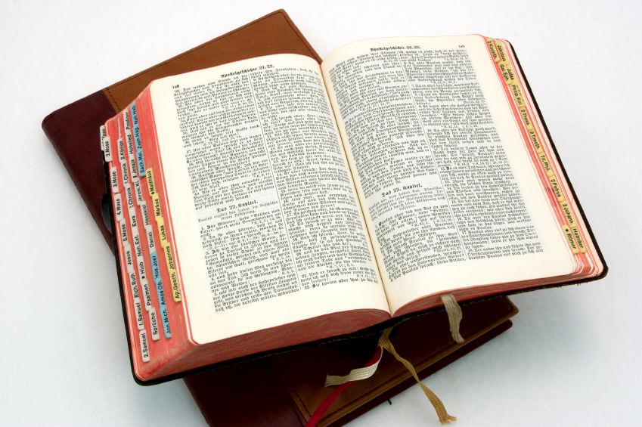
Hear: Romans 10:17
So then faith cometh by hearing, and hearing by the word of God.

Slide 31
Believe: Hebrews 11:6
But without faith it is impossible to please him: for he that cometh to God must believe that he is, and that he is a rewarder of them that diligently seek him.

Slide 32
Repent: Luke 13:3
I tell you, Nay: but, except ye repent, ye shall all likewise perish.

Slide 33
Confess: Matthew 10:32-33
32 Whosoever therefore shall confess me before men, him will I confess also before my Father which is in heaven.
33 But whosoever shall deny me before men, him will I also deny before my Father which is in heaven.

Slide 34
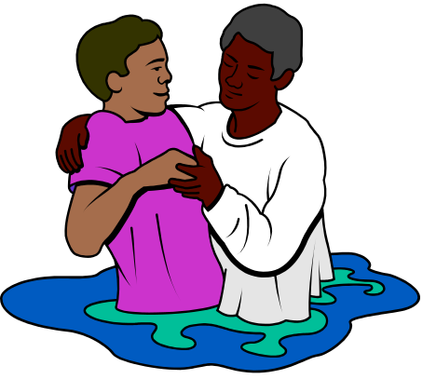
Baptize: Acts 22:16
And now why tarriest thou? arise, and be baptized, and wash away thy sins, calling on the name of the Lord.

